Slide 1

Experiential Learning Project Assessment-I on
“Mad Libs Generator in Python”
Python Programming Language (N-PCCCM304P)
Presented By
Saloni Manoj Edalwar (CM25049)
Under the Guidance of
Mrs. Mayuri Getme
Session: 2026-27 (ODD)
Department of CSE (AI&ML)
S. B. JAIN INSTITUTE OF TECHNOLOGY MANAGEMENT AND RESEARCH, NAGPUR
An Autonomous Institute, Affiliated to RTMNU, Nagpur

Slide 2
Problem Statement & Objectives
Problem Statement
Develop a basic Python-based Mad Libs Generator that collects different words such as nouns, verbs, adjectives, and places from the user. The program should use these inputs with predefined story templates to generate a creative and entertaining story..
Objectives
To develop a simple Mad Libs Generator using Python.
To collect different types of words from the user.
To generate creative stories using predefined templates
To demonstrate basic Python concepts like input, variables, strings, and conditional statements.
To make the program interactive and entertaining
S. B. Jain Institute of Technology Management and Research

Slide 3
Algorithm
011
Start Begin the Mad Libs Generator program.
02
Choose Template Display the menu and let the user select a story template.
03
Take Inputs Ask for words such as name, noun, verb, adjective, adverb and place.
04
Build Story Insert the entered words into the selected predefined template.
05
Generate Create the complete and entertaining story.
06
Display & Stop Show the generated story and end the program.
S. B. Jain Institute of Technology Management and Research

Slide 4
Pseudocode & Flowchart
START
START
Display available story templates Ask user to choose a template Collect required words:
noun, verb, adjective, adverb, place… Insert words into the selected template Generate the completed story
Display the funny story Ask: “Play again?”
IF Yes → repeat from template selection
IF No → END
Choose story template
Enter words / inputs
yeyes
Fill template with words
Display generated story
END
Play again?
S. B. Jain Institute of Technology Management and Research

Slide 5
Understanding of Python Logic
0
1
INPUT
0
LOGIC
0
4
OUTPUT
0 3
2
PROCESS
Take words from the user
Insert words into a template
conditions • loops • functions
Generate and display the story
Store and organize the inputs
noun • verb • adjective • place
formatted text • user feedback
variables • lists • strings
PYTHON LOGIC IN THE PROJECT
Variables
Store each word entered by the user
String Formatting
Combine words with the story template
KEY IDEA
Input → Process → Decision → Output
If / Else
Validate choices and handle play-again logic
Allow multiple rounds of story generation
Loops
Functions
Separate input, story generation and display
S. B. Jain Institute of Technology Management and Research

Slide 6
GitHub Workflow
•
•
•
•
Created a GitHub account and repository: Mad libs generator in python
Added a README.md explaining the project overview and usage Maintained commit history to reflect individual contribution Used .gitignore to exclude unnecessary files
Sample Commit Messages
•
“Initial commit: Add Mad Libs Generator”
“Add README documentation for Mad Libs project” “Add Mad Libs story generator program”
“Add Mad Libs story generator program”
“Add pseudocode and flowchart documentation” “Add Mad Libs Generator with documentation”
•
•
•
•
•
S. B. Jain Institute of Technology Management and Research

Slide 7
Phase 2: What I Added
PHASE 2
From a basic story generator to a more interactive program
70% PROJECT DEVELOPMENT
1
Multiple stories — added 3 different story templates.
Random choice — the program can select a story automatically.
Input checking — blank input is not accepted.
Menu system — Random Story, Choose Story, or Exit.
Functions — each task is kept in a simple function.
Repeat use — more than one story can be generated in one run.
S. B. Jain In

Slide 8
Code Structure
PHASE 2
Simple functions make the program easy to understand and explain
1
get_inpu t()
Checks input
2
get_word s()
Collects words
3
story_on e/two/
4
choose_s tory()
Selects a story
5
main()
→
→
three()
→
→
Builds stories
Controls program
Example: collecting user input
def get_input(message):
while True:
value = input(message).strip() if value != "":
return value
print("Please enter something!")
def get_words(): words = {}
words["name"] = get_input("Enter a name: ") words["noun"] = get_input("Enter a noun: ") words["verb"] = get_input("Enter a verb: ") return words
S. B. Jain In

Slide 9
Coding: Story Templates & Random Selection
PHASE 2
1. Story template 2. Random selection
def story_one(words): return f"""
Once upon a time,
{words["name"]}
found a {words["animal"]}. The day became very
{words["adjective"]}! """
def generate_random_story(words): stories = [
story_one, story_two, story_three
]
return random.choice(stories) (words)
Why this is useful
More variety a random story
Less repetition • User can choose or get
S. B. Jain In

Slide 10
Coding: Menu & Input Validation
PHASE 2
These parts make the program interactive and easier to use
MENU
VALIDATION
value = input(message).strip()
Generate a Random Story
Choose a Story
Exit
if value != "": return value
else:
print("Please enter something!")
Easy explanation
The menu tells the user what they can do. If the user leaves a word blank, the program asks again instead of accepting empty data.
S. B. Jain In

Slide 11
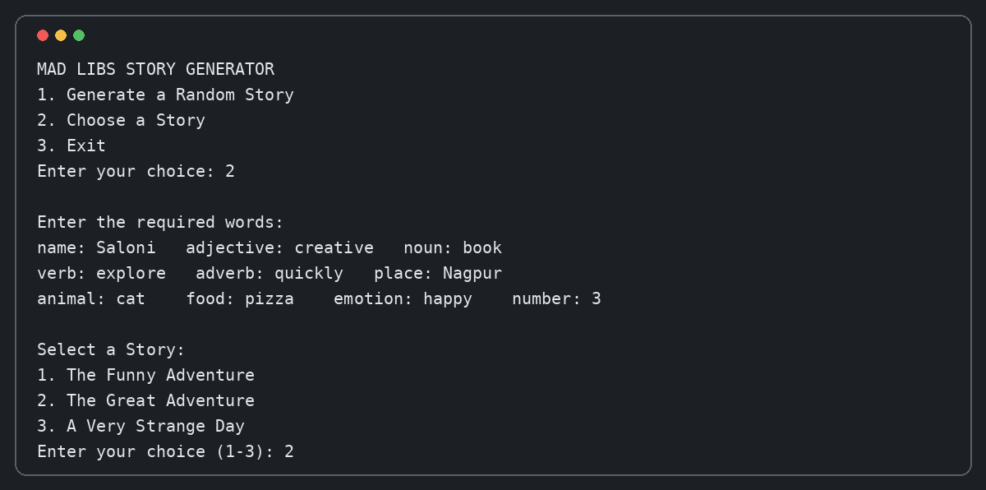
Execution 1: Choosing a Story
PHASE 2
Sample run of the Phase 2 program
Example inputs: Saloni • creative • book • explore • Nagpur • cat • pizza
S. B. Jain In

Slide 12
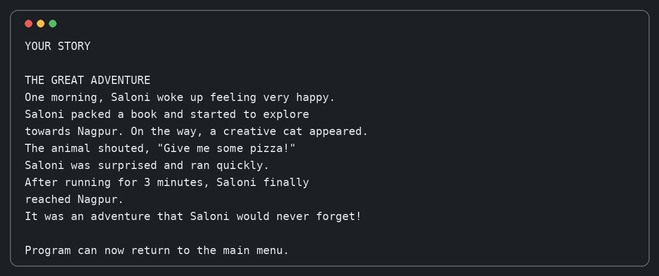
Execution 2: Generated Story
PHASE 2
The program combines the inputs into a complete story
Result: a different story is generated from the user's own words.
S. B. Jain In

Slide 13
Thank You
S. B. Jain Institute of Technology Management and Research

